Slide 1
Hospital Routing Problem
Using Ant Colony Optimization VRPTW

Slide 2
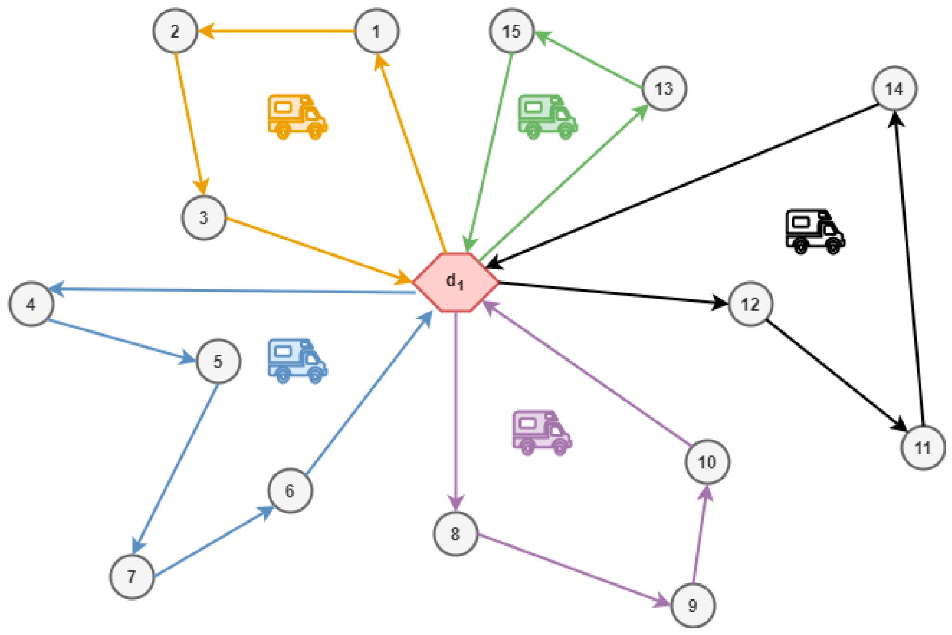
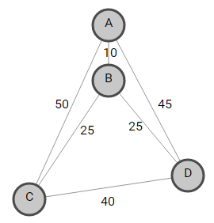

Slide 3
Food
A
An Ant’s nest
Search procedure: each ant is going out looking for food
More ants will follow one pheromone trail
B
D
C

Slide 4
The ACO algorithm
Best Tour := NIL
repeat
Randomly place M ants on N cities
each ant constructs a tour in a greedy stochastic manner
update best_tour
Each ant deposits pheromone on tour edges*
Until a termination criteria is met
return best_tour
*In the real world, ant keeps on depositing pheromone

Slide 5
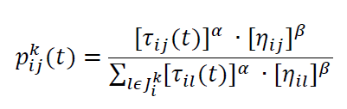
VRP- ACO()
Best Tour := NIL
repeat
Randomly place M ants on N cities
for each ant a
for n<- 1 to N
ant a selects and edge from the distribution Pn
update best_tour
for each ant a
for each edge (u,v) in ant’s tour
deposit pheromone ∝ 1/tour length of the edge
Until a termination criteria is met
return best_tour
On city i, kth ant moves to city j
Pheromone on the edge (i,j) is given by τ_{ij}
Visibility which is inversely proportional to the distance between cities i and j is η_{ij}

Slide 6
Multi-objective
VRPTW
Single objective
ACS-Vehicle
ACS-Time
Artificial multiple ants
Artificial multiple ants
Solution

Slide 7
procedure ACS-VEI
/* cycle */
/* compute number of times a patient has visited*/
/* initialize pheromone and data structure and initialize solution with N hospitals using nearest neighbour heuristic*/
for each ant k:
construct a solution 𝜙^{k}
insert(INj)
new_ant()
/*update for best solution if it is improved*/
if visited_patients(𝜙^{k}) > visited_patients(𝜙^{ACS-VEI})
𝜙^{ACS-VEI} := 𝜙^{k}
/* if feasible, send for VRPTW */
/* perform update on both 𝜙^{k} and 𝜙^{ACS-VEI} */
τ_{ij} = (1-ρ)τ_{ij} +ρ/J^{k}
τ_{ij} = (1-ρ)τ_{ij} +ρ/J^{ACS-VEI}
until a stopping condition is met

Slide 8
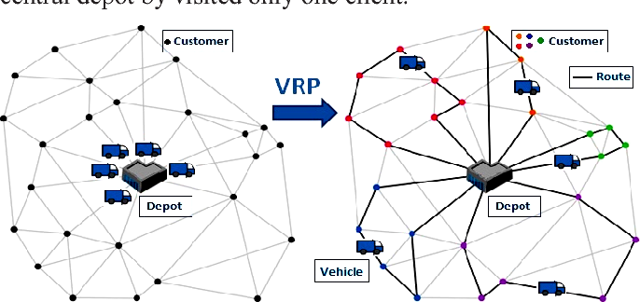
Bringing ACS-VEI and ACS-TIME together
/*initialization*/
/* main loop */
repeat
v:=active_vehicles()
Activate ACS-VEI(v-1)
Activate ACS-TIME(v)
while ACS-VEI and ACS-TIME are active:
wait for an improved solution
end while after a base case is met
ACS-VEI: minimizing the number of vehicles
Source: Semantic Scholar

Slide 9
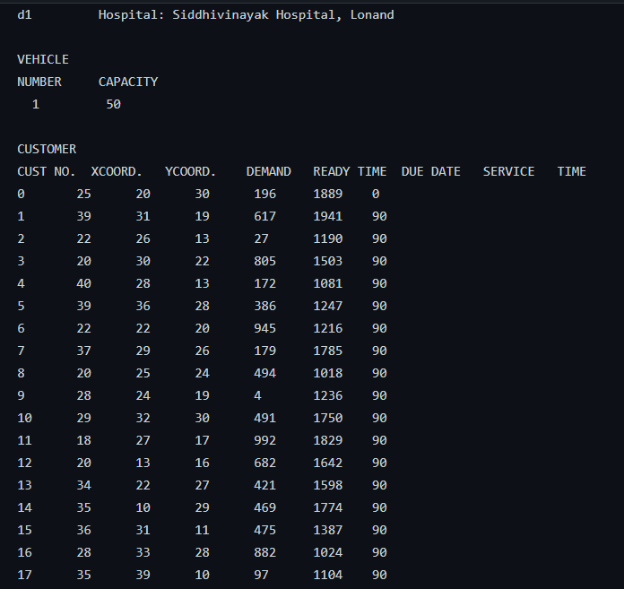
Dataset

Slide 10
Start
Future Scope
Build an IoT for hospitals, medical shops, patients etc.
Send request to server for data
P^{new}<P^{prev}
YES
NO
New path
Prev Path
End

